Slide 1



STEERING
CS 483: Big Data Mining
Predictive Analytics in Road Safety: A Machine Learning Approach to Traffic Accident Analysis
Team 28
Group Members:
Manan Jain,
Hemanth Nagulapalli, Sravan Nekkanti,
Surya Reddy Nallamilli

Slide 2
Motivation
- Public Safety Challenge: Address the critical issue of traffic accidents, aiming to reduce injuries and fatalities.
- Data-Driven Prevention: Utilize extensive accident data to understand and predict conditions leading to accidents.
- Minimizing Loss of Life: Focus on saving lives by identifying and mitigating high-risk situations on the road.
- Navigational Insights: Provide better insights for navigating traffic, enhancing overall road safety.
- Predictive Analysis: Use predictive modeling to foresee and prevent potential traffic accidents.
- Supporting Road Safety: Offer support and solutions for safer driving conditions through data analysis.

Slide 3
Formalization
- Severity and Likelihood Prediction: Determine the severity and likelihood of traffic accidents using environmental and spatial factors.
- Machine Learning Application: Employ machine learning techniques to develop predictive models for accident severity and likelihood.
- Utilizing U.S. Accidents Dataset: Base analysis on the comprehensive data collected in the “U.S. Accidents” dataset.
- Accurate Predictive Models: Aim to create models that accurately predict traffic accident severity and likelihood.

Slide 4
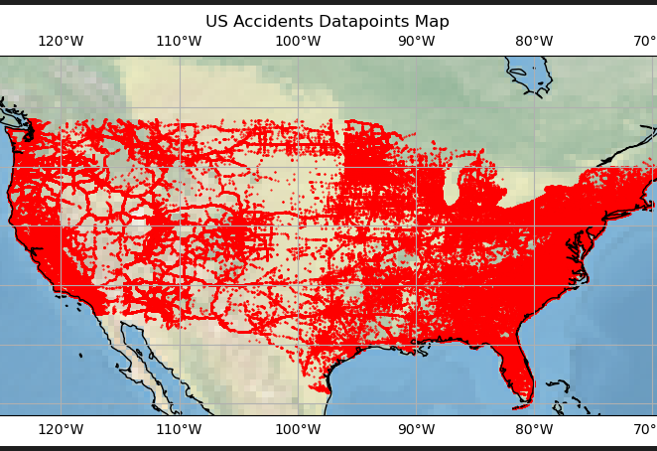
Dataset and Preprocessing
Dataset
U.S. Accidents (2016-2023)
This dataset was extracted using Bing API and MapQuest
Measures:
Severity (1-4)
Location
Weather conditions
Road conditions
etc.

Slide 5
Features available
Severity - Specifies the severity of the traffic caused by the accident
Road feature
Roundabout
Crossing
Junction
Bump
Railway
Station
Stop
Traffic Signal
Amenity
Weather
Humidity
Visibility
Temperature
Wind Chill
Wind Direction and Speed
Pressure
Weather Condition
Sunrise or Sunset
Location of the accident
Start Longitude and Start Latitude
End Longitude and End Latitude
Address

Slide 6
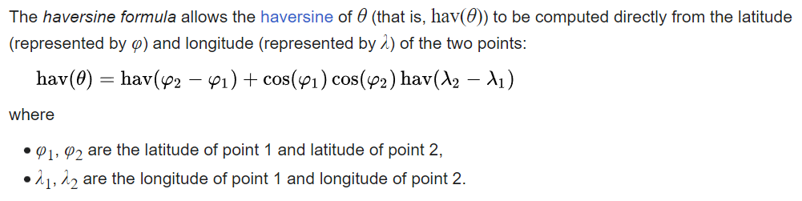
Preprocessing
Missing one or multiple weather features
Open weather API limitations (100 calls daily) hindered complete data filling.
Aimed to enhance dataset completeness despite API constraints.
Innovative approach: Utilized latitude and longitude to identify entries within a 5-mile radius.
Applied Haversine formula to calculate proximity-based weather conditions for missing rows.
Considered data from three days around the timestamp to refine weather information.
Averaged missing values based on information gathered from the surrounding area and timeframe.

Slide 7
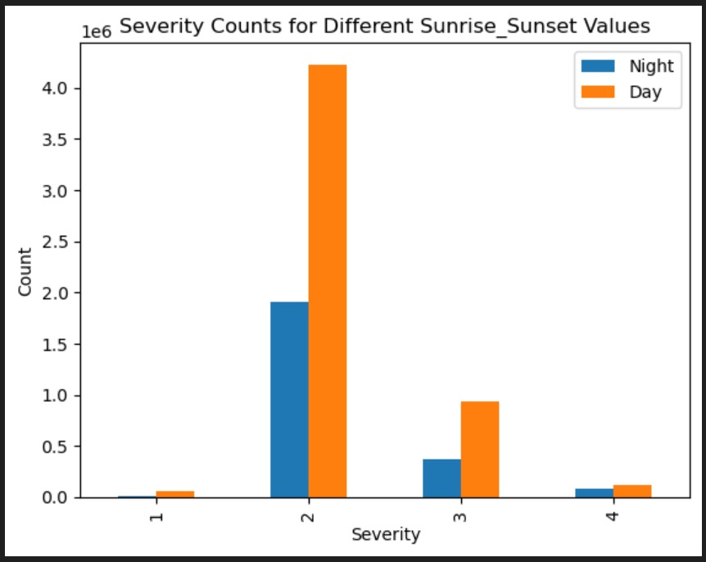

Slide 8
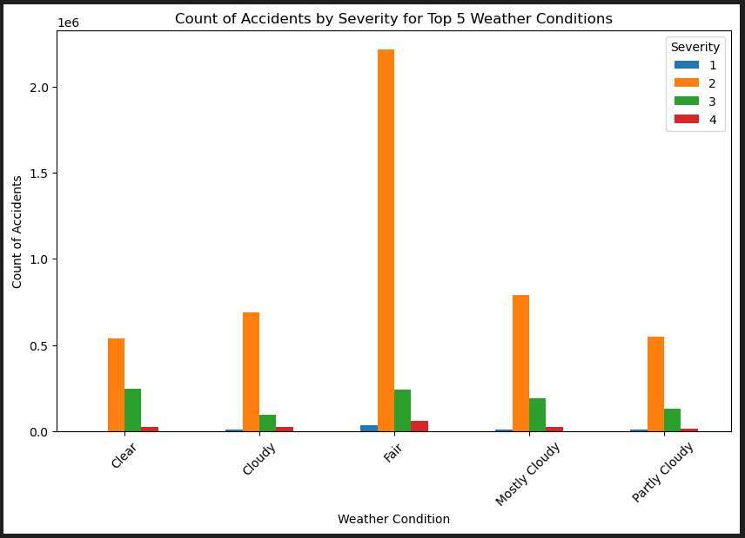

Slide 9
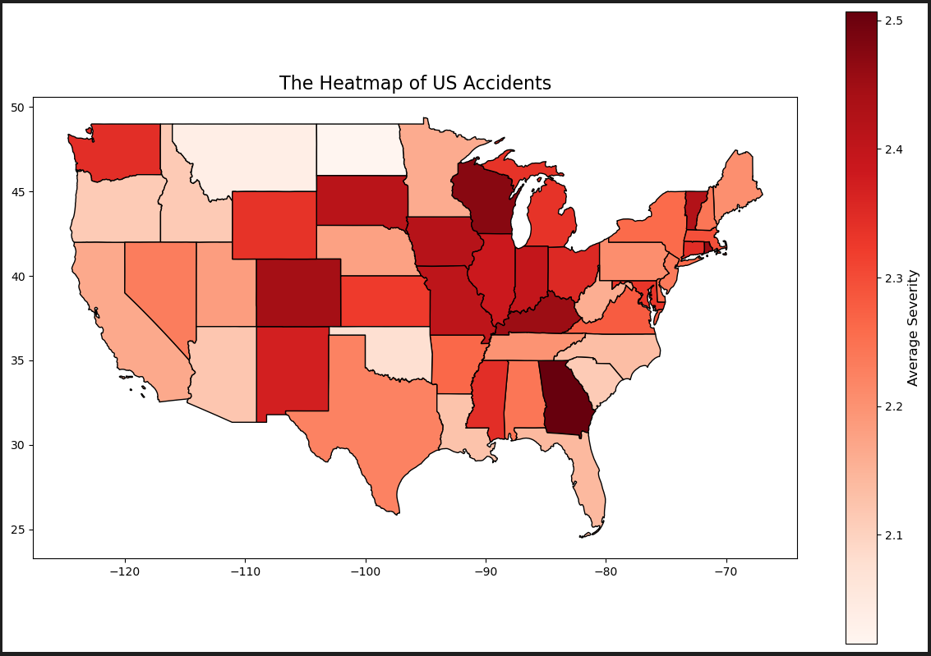

Slide 10
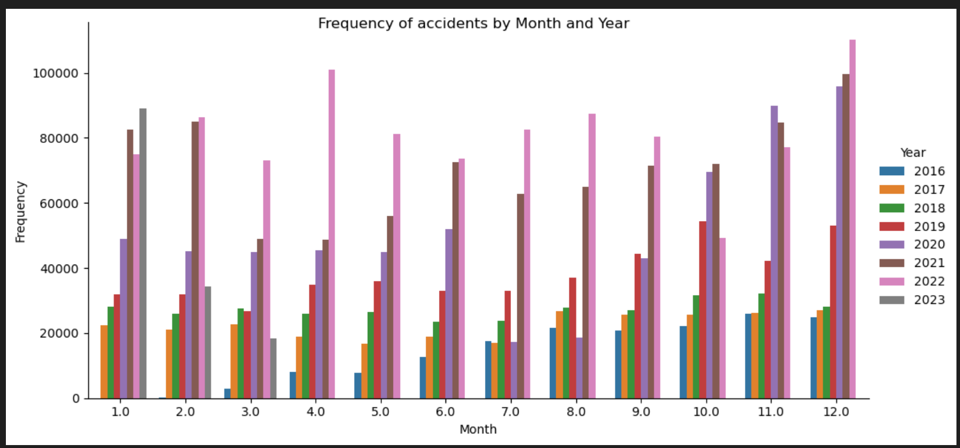

Slide 11
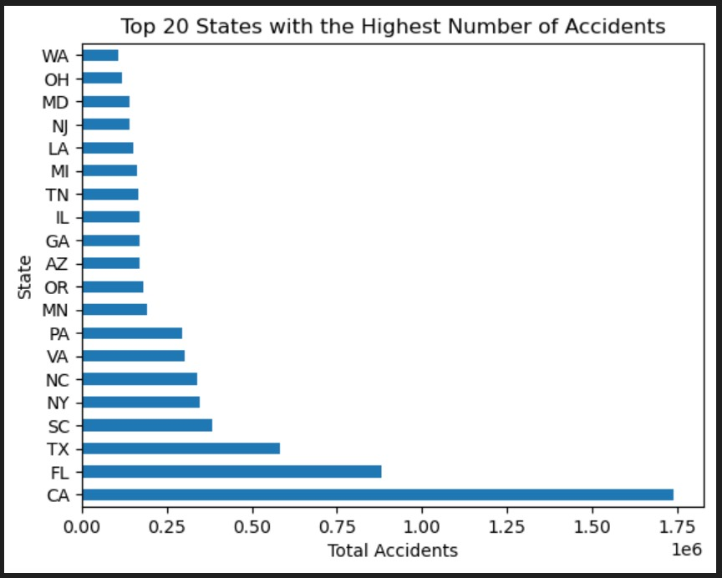

Slide 12
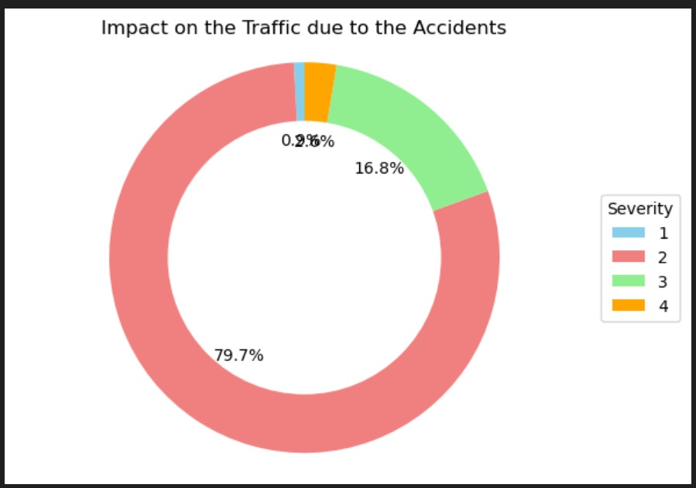
2.6%
0.9%

Slide 13
Modelling Techniques
Random Forest
Decision Tree
Support Vector Machine (SVM)
Logistic Regression
Gradient Boosting
Multilayer Perceptron (MLP)
We have divided the dataset into a 30/70 split as in for testing and training respectively
Five-fold cross validation

Slide 14
Results
Random Forest Metrics:
Accuracy: 92.25%
Precision: 0.92
Recall: 0.92
F1 Score: 0.92
Decision Tree Metrics:
Accuracy: 89.63%
Precision: 0.90
Recall: 0.90
F1 Score: 0.90
SVM Metrics:
Accuracy: 85.56%
Precision: 0.85
Recall: 0.86
F1 Score: 0.84
Logistic Regression Metrics:
Accuracy: 81.66%
Precision: 0.79
Recall: 0.82
F1 Score: 0.79
Gradient Boosting Metrics:
Accuracy: 91.81%
Precision: 0.92
Recall: 0.92
F1 Score: 0.91
MLP Metrics:
Accuracy: 88.78%
Precision: 0.88
Recall: 0.89
F1 Score: 0.88

Slide 15
Lessons Learned
Based on the results, it is optimal to prefer Random Forest or Gradient Boosting for their high accuracy and stability.
The Immense amount of variables in real world scenarios from weather to location as well as real time changes affect the road conditions.
Clubbing together different data sources leads to a better understanding and prediction of the severity of accidents that can happen, as it better models the real world.
The missing values for locations indicate the difficulty in collecting data as gps tracking gets destroyed in severe accidents
After the running the models, the highest weights were assigned to the state and city for location, as well as humidity, temperature and visibility for the weather data.

Slide 16
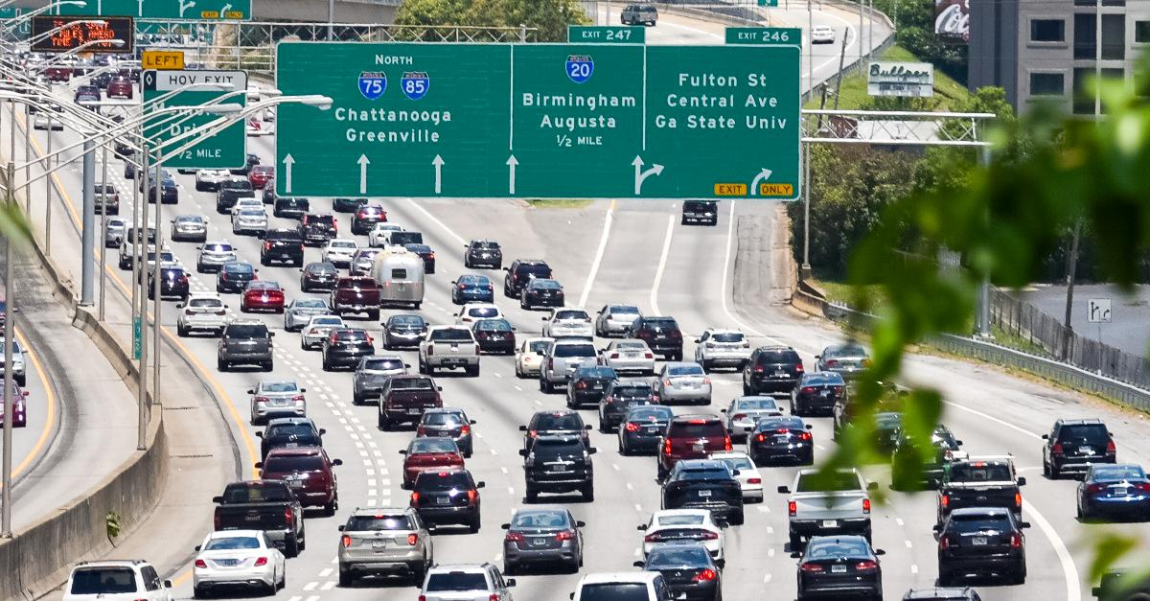
Challenges and Future work
The handling of immense data was a challenge, taxing our machines to the limit.
Handling missing data was a challenge along with the aggregation of more recent data.
The use of description can be optimised along with the tuning of further hyper parameters with metadata such as area around the accident, like schools, hospitals etc.

Slide 17
Q&A?

